Slide 1
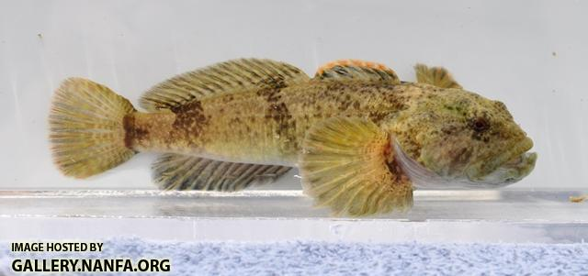
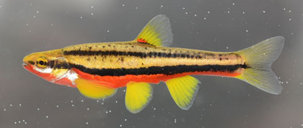
Modeling zero-inflated count data in R
LunchinatoRs Presentation:
Brett Kelly
06/05/2020

Slide 2
Primer:
Not an expert!
Objectives:
Introduce you to zero-inflated models & pscl package
Receive feedback on modeling specifics
Statistical alternatives?
Cool fish pics

Slide 3
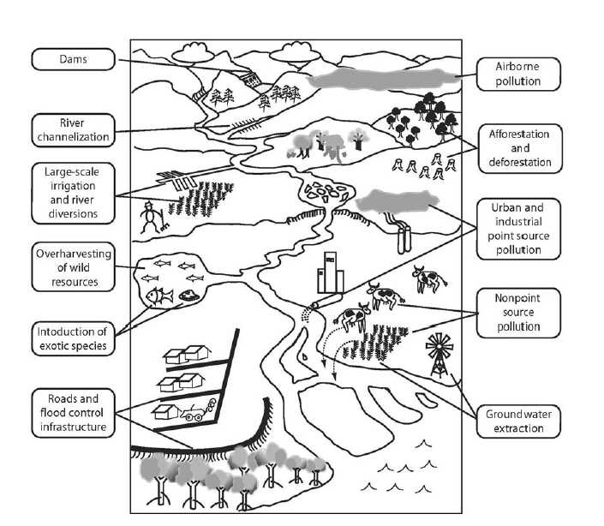
Background
Carpenter et al. 2011
Study Purpose:
Assess stream fish communities in Northeast Iowa
Evaluate distributions and relationships with habitat features and non-native piscivore

Slide 4

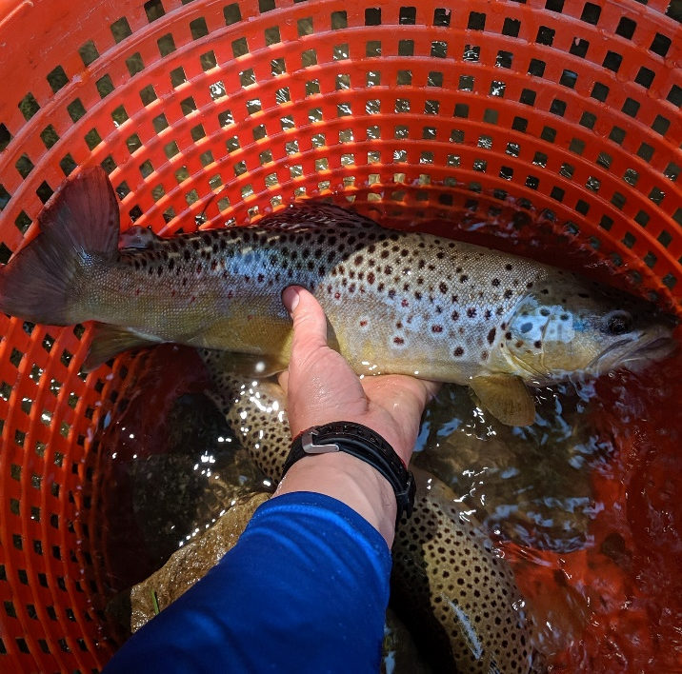
Background
Study Purpose:
Assess stream fish communities in Northeast Iowa
Evaluate distributions and relationships with habitat features and non-native piscivore

Slide 5
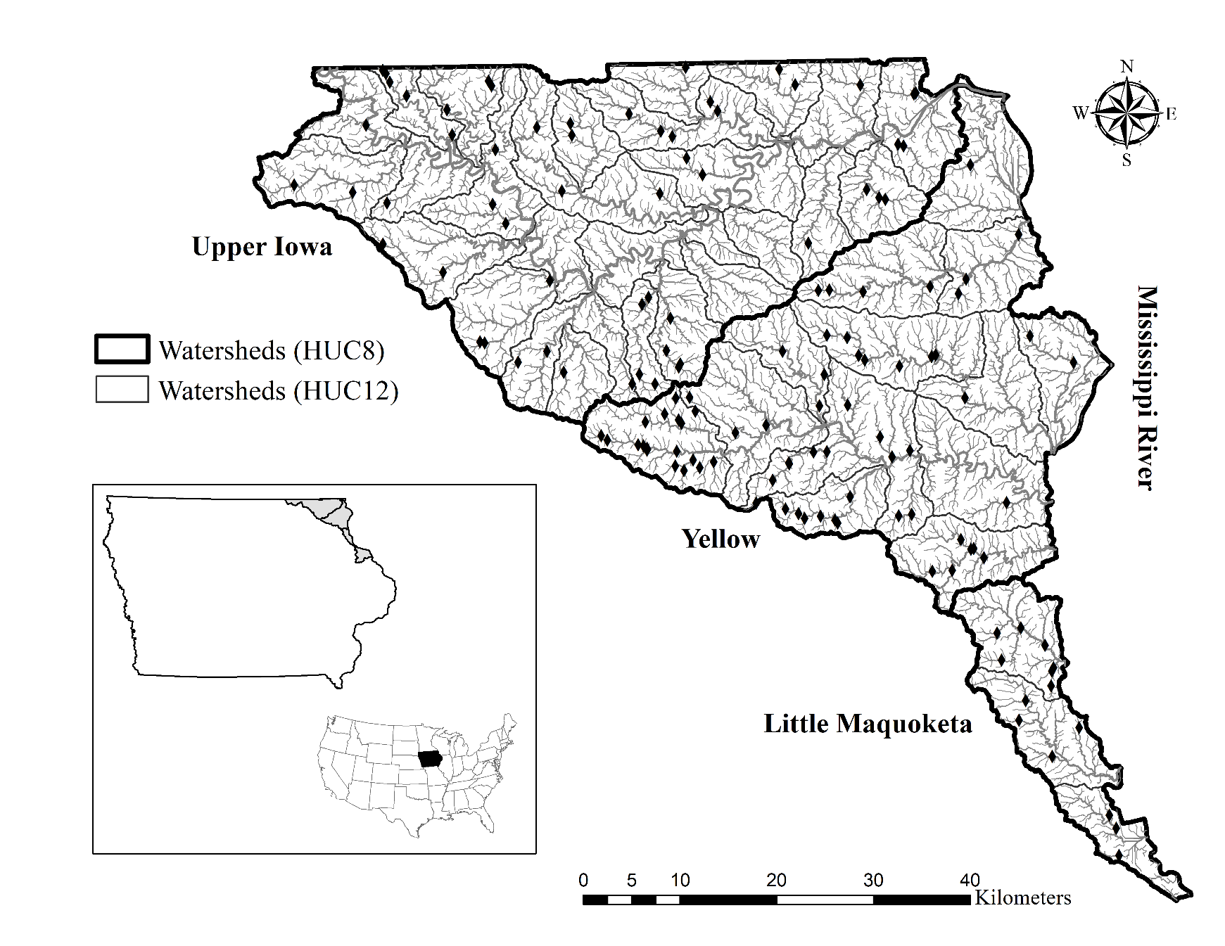
Background
Study Area:
NE Iowa
Driftless Area ecoregion
Upper Iowa, Yellow, Little Maquoketa watersheds

Slide 6
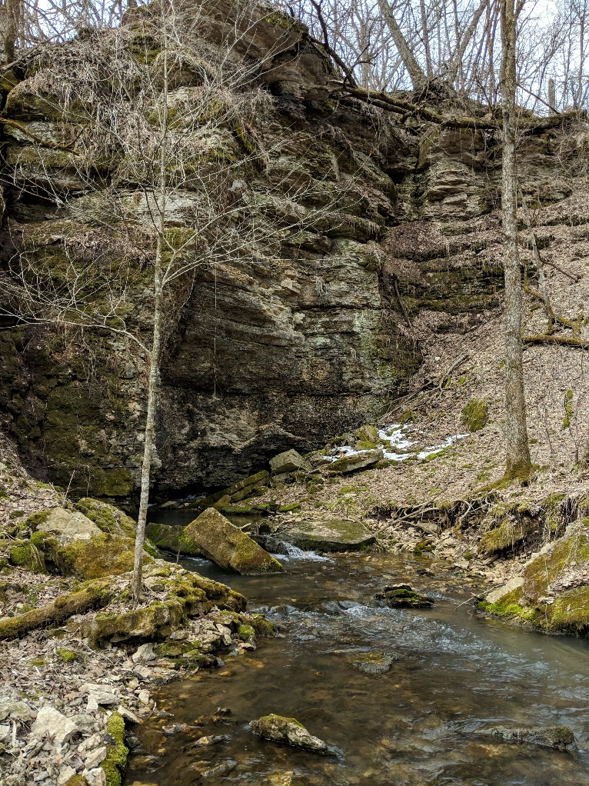



Background
Focal species and habitats:
Am smol.

Slide 7

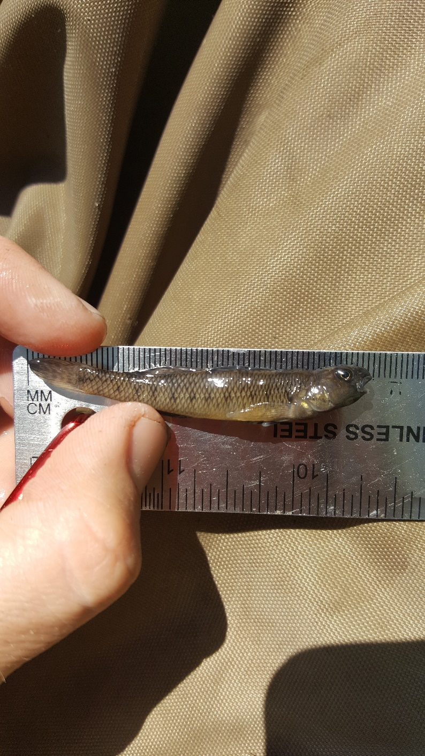
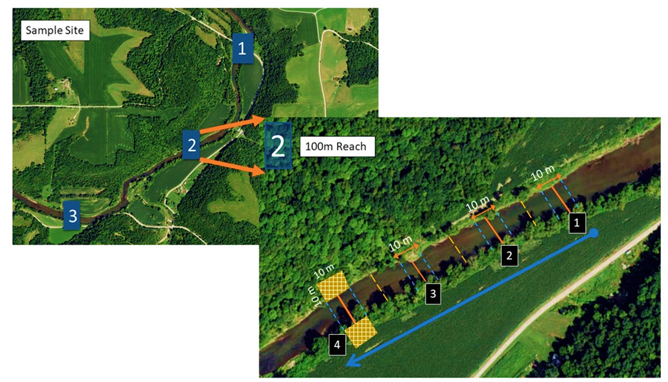

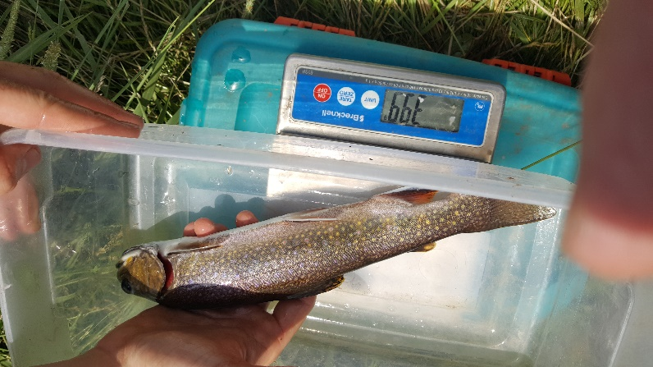
Methods: Data collection

Slide 8
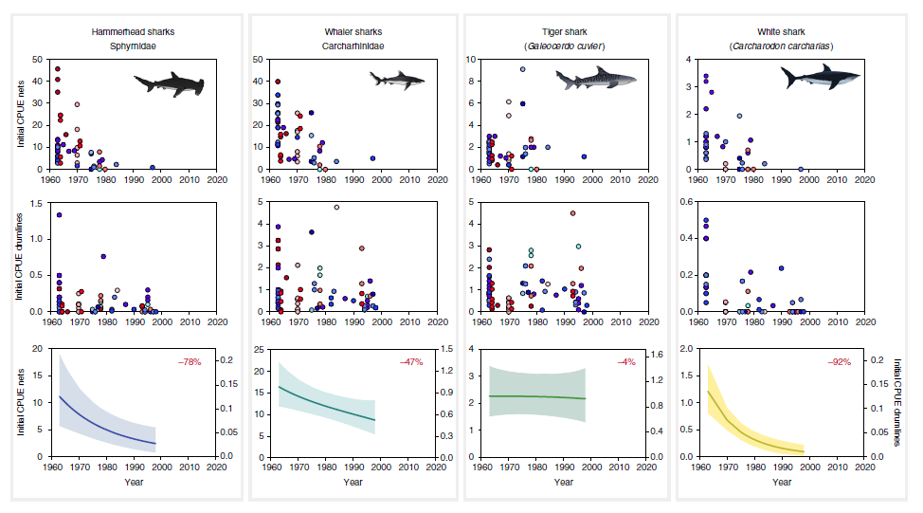
Methods: Analysis
Goals:
Determine relationship strength and direction
Predict species counts based on covariates
Response Variable of interest:
Species specific counts
Typical standard in fisheries is CPUE or in streams (#fish/length sampled)
Explanatory Variables:
Habitat features:
Watershed level
Instream and riparian
Brown Trout:
Median body length (mm)
Relative abundance (CPUE)
Roff et al. 2018

Slide 9


Slide 10
Model Options:
Zero-inflated poisson/negative binomial models
Fixed effects only:
pscl package
Can Incorporate random effects:
GLMMadaptive*
glmmTMB*
*Not covered in this talk but seems powerful and well documented. Will provide links at end.
Other considerations:
Are data zero-inflated?
Ordinary Poisson and Negative Binomial models may perform better if there are not excess zeros
Poisson vs. Negative Binomial?
Poisson for when data is not overdispersed (variance not much larger than mean)

Slide 11
Poisson vs. Negative Binomial:
“LOL wow an excel table ”
Species | Mean Count (present) | SD (present) | Variance (present) | Occurrence | % Zeros
Sculpin | 8.86 (61.6) | 38.12 (84.46) | 1453.046 (7134.15) | 20/139 | 86%
Longnose Dace | 4.89 (20.61) | 18.65 (34.15) | 347.89 (1166.37) | 33/139 | 76%
Southern Redbelly Dace | 3.91 (16.48) | 19.54 (37.86) | 381.96 (1433.51) | 33/139 | 76%

Slide 12
Poisson vs. Negative Binomial:
Conclusion: For all three species, variance is larger than mean & heavily zero-inflated, so I chose the zero-inflated negative binomial option for this data analysis.
Species | Mean Count (present) | SD (present) | Variance (present) | Occurrence | % Zeros
Sculpin | 8.86 (61.6) | 38.12 (84.46) | 1453.046 (7134.15) | 20/139 | 86%
Longnose Dace | 4.89 (20.61) | 18.65 (34.15) | 347.89 (1166.37) | 33/139 | 76%
Southern Redbelly Dace | 3.91 (16.48) | 19.54 (37.86) | 381.96 (1433.51) | 33/139 | 76%

Slide 13
Zero-inflated Model Description
Assumes that a “zero” is due to two different processes
In our case:
The fish occupies a site
If present, count process due to ___habitat and Brown Trout variables____
The fish is absent from site
If absent, only possible outcome is zero
Absence may be function of randomness or,
Extra zero processes can be modeled using covariates
Do not have to be the same as in the count process
IMO, this is where random effect option may be interesting
Likelihood function
theory explained in links provided at end

Slide 14

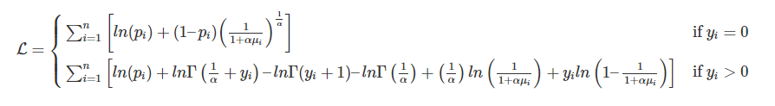
Zero-inflated Model Description
Assumes that a “zero” is due to two different processes
In our case:
The fish occupies a site
If present, count process due to ___habitat and Brown Trout variables____
The fish is absent from site
If absent, only possible outcome is zero
Absence may be function of randomness or,
Extra zero processes can be modeled using covariates
Do not have to be the same as in the count process
IMO, this is where random effect option may be interesting
Likelihood function
theory explained in links provided at end

Slide 16
General Conclusions, Issues, Questions
Pscl package useful for modeling zero-inflated count data & well documented
------------------------------------------------------------------------------------------------------
Is this a well-intentioned analysis, with insufficient data?
Many zeros
Even when present, many low counts
What are some other things I should check now that model is fit?
An idea
Remove sites where absent, BUT – lose information and not objective
Other analyses that may be interesting?
------------------------------------------------------------------------------------------------------
What I did instead for thesis chapter: occupancy modeling using presence/absence information

Slide 17
Useful Links:
Zero-inflated models that can handle random effects:
glmmTMB
https://cran.r-project.org/web/packages/glmmTMB/glmmTMB.pdf
GLMMadaptive
https://drizopoulos.github.io/GLMMadaptive/
https://cran.r-project.org/web/packages/GLMMadaptive/GLMMadaptive.pdf
pscl package:
Tutorial
Zero-inflated negative binomial: https://stats.idre.ucla.edu/r/dae/zinb/
Paper covering regressions for count data
https://cran.r-project.org/web/packages/pscl/vignettes/countreg.pdf
CRAN
https://cran.r-project.org/web/packages/pscl/index.html
https://cran.r-project.org/web/packages/pscl/pscl.pdf
Random post explaining offset variables well
https://github.com/atahk/pscl/issues/5
“Regular” Negative binomial regression
MASS package
Function: glm.nb
Tutorial: https://stats.idre.ucla.edu/r/dae/negative-binomial-regression/

